Slide 1
Interpretable Multivariate Time Series Classification
UCD-Accenture Labs Project Presentation
Iulia Ilie, Luca Costabello, Freddy Lecue, Georgiana Ifrim
iulia.ilie@ucd.ie, georgiana.ifrim@ucd.ie

Slide 2
Outline
Multivariate Time Series Classification and Interpretation
MTSC by Genetic Programming: CMAGEP-MTSC
CMAGEP-MTSC vs SOTA: Results
Future Work

Slide 3
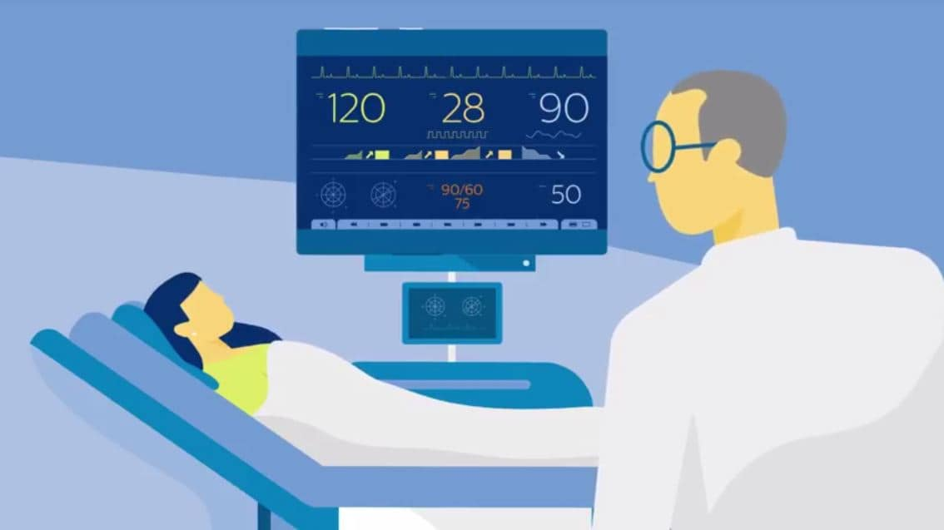
Multivariate Time Series (MTS)
A time series is a temporally ordered (numeric) sequence.
MTS contain multiple dimensions.
Notes:
MTS are recorded in a very large space of domains

Slide 4


Multivariate Time Series Classification (MTSC)
The task of mapping an MTS to a class type.
Class Label
time

Slide 5
Interpreting the Classification Decision
Why should the classification decision be explainable?
Confirmation
Accountability
Cost protection
Debugging
Notes:
Although complex algos have reached levels of accuracy often beating human capacity, due to black-box or complex transformations, understanding the class decision is still difficult.

Slide 6
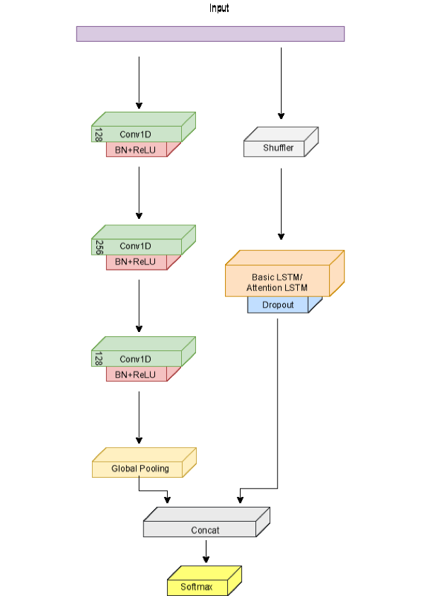
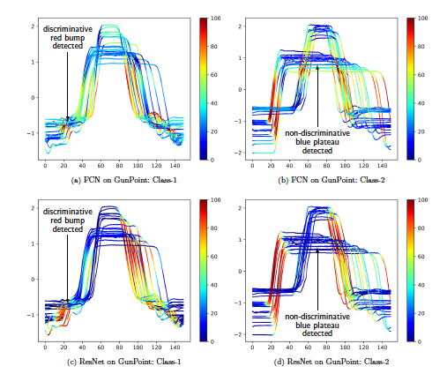
MTSC SOTA
(Karim, Majumdar, Darabi, & Harford, 2018)
MLSTMFCN
MUSE, Schafer et al, 2017
CAM, Fawaz et al, 2019
Notes:
Examples of SOTA MTSC for accuracy include TS trans based approaches, RF approaches and deep learning.
In deep learning, Forrestier proposed CAM for visualizing the decision making.

Slide 7
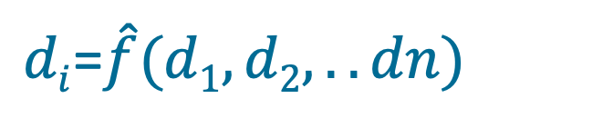
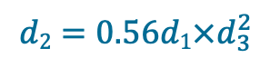
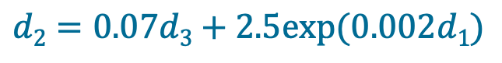
Discovering Inter-dimensional Relationships
$di$=$\hat{f}(d1,d2,..dn)$
d₁
d₁
d₂
d₂
d₃
d₃
time
time
$$d2=0.07d3+2.5exp⁡(0.002d1)$$
$$d2=0.56d1×d_{3}^{2}$$
Notes:
We propose an alternative solution:
Automaticaly discover rel between dimensions for each class as regressions, and use these models to make classification decisions.
Hypothesis: different classes have different relationships between dimensions (point to example relation for class 1 and 2)

Slide 8
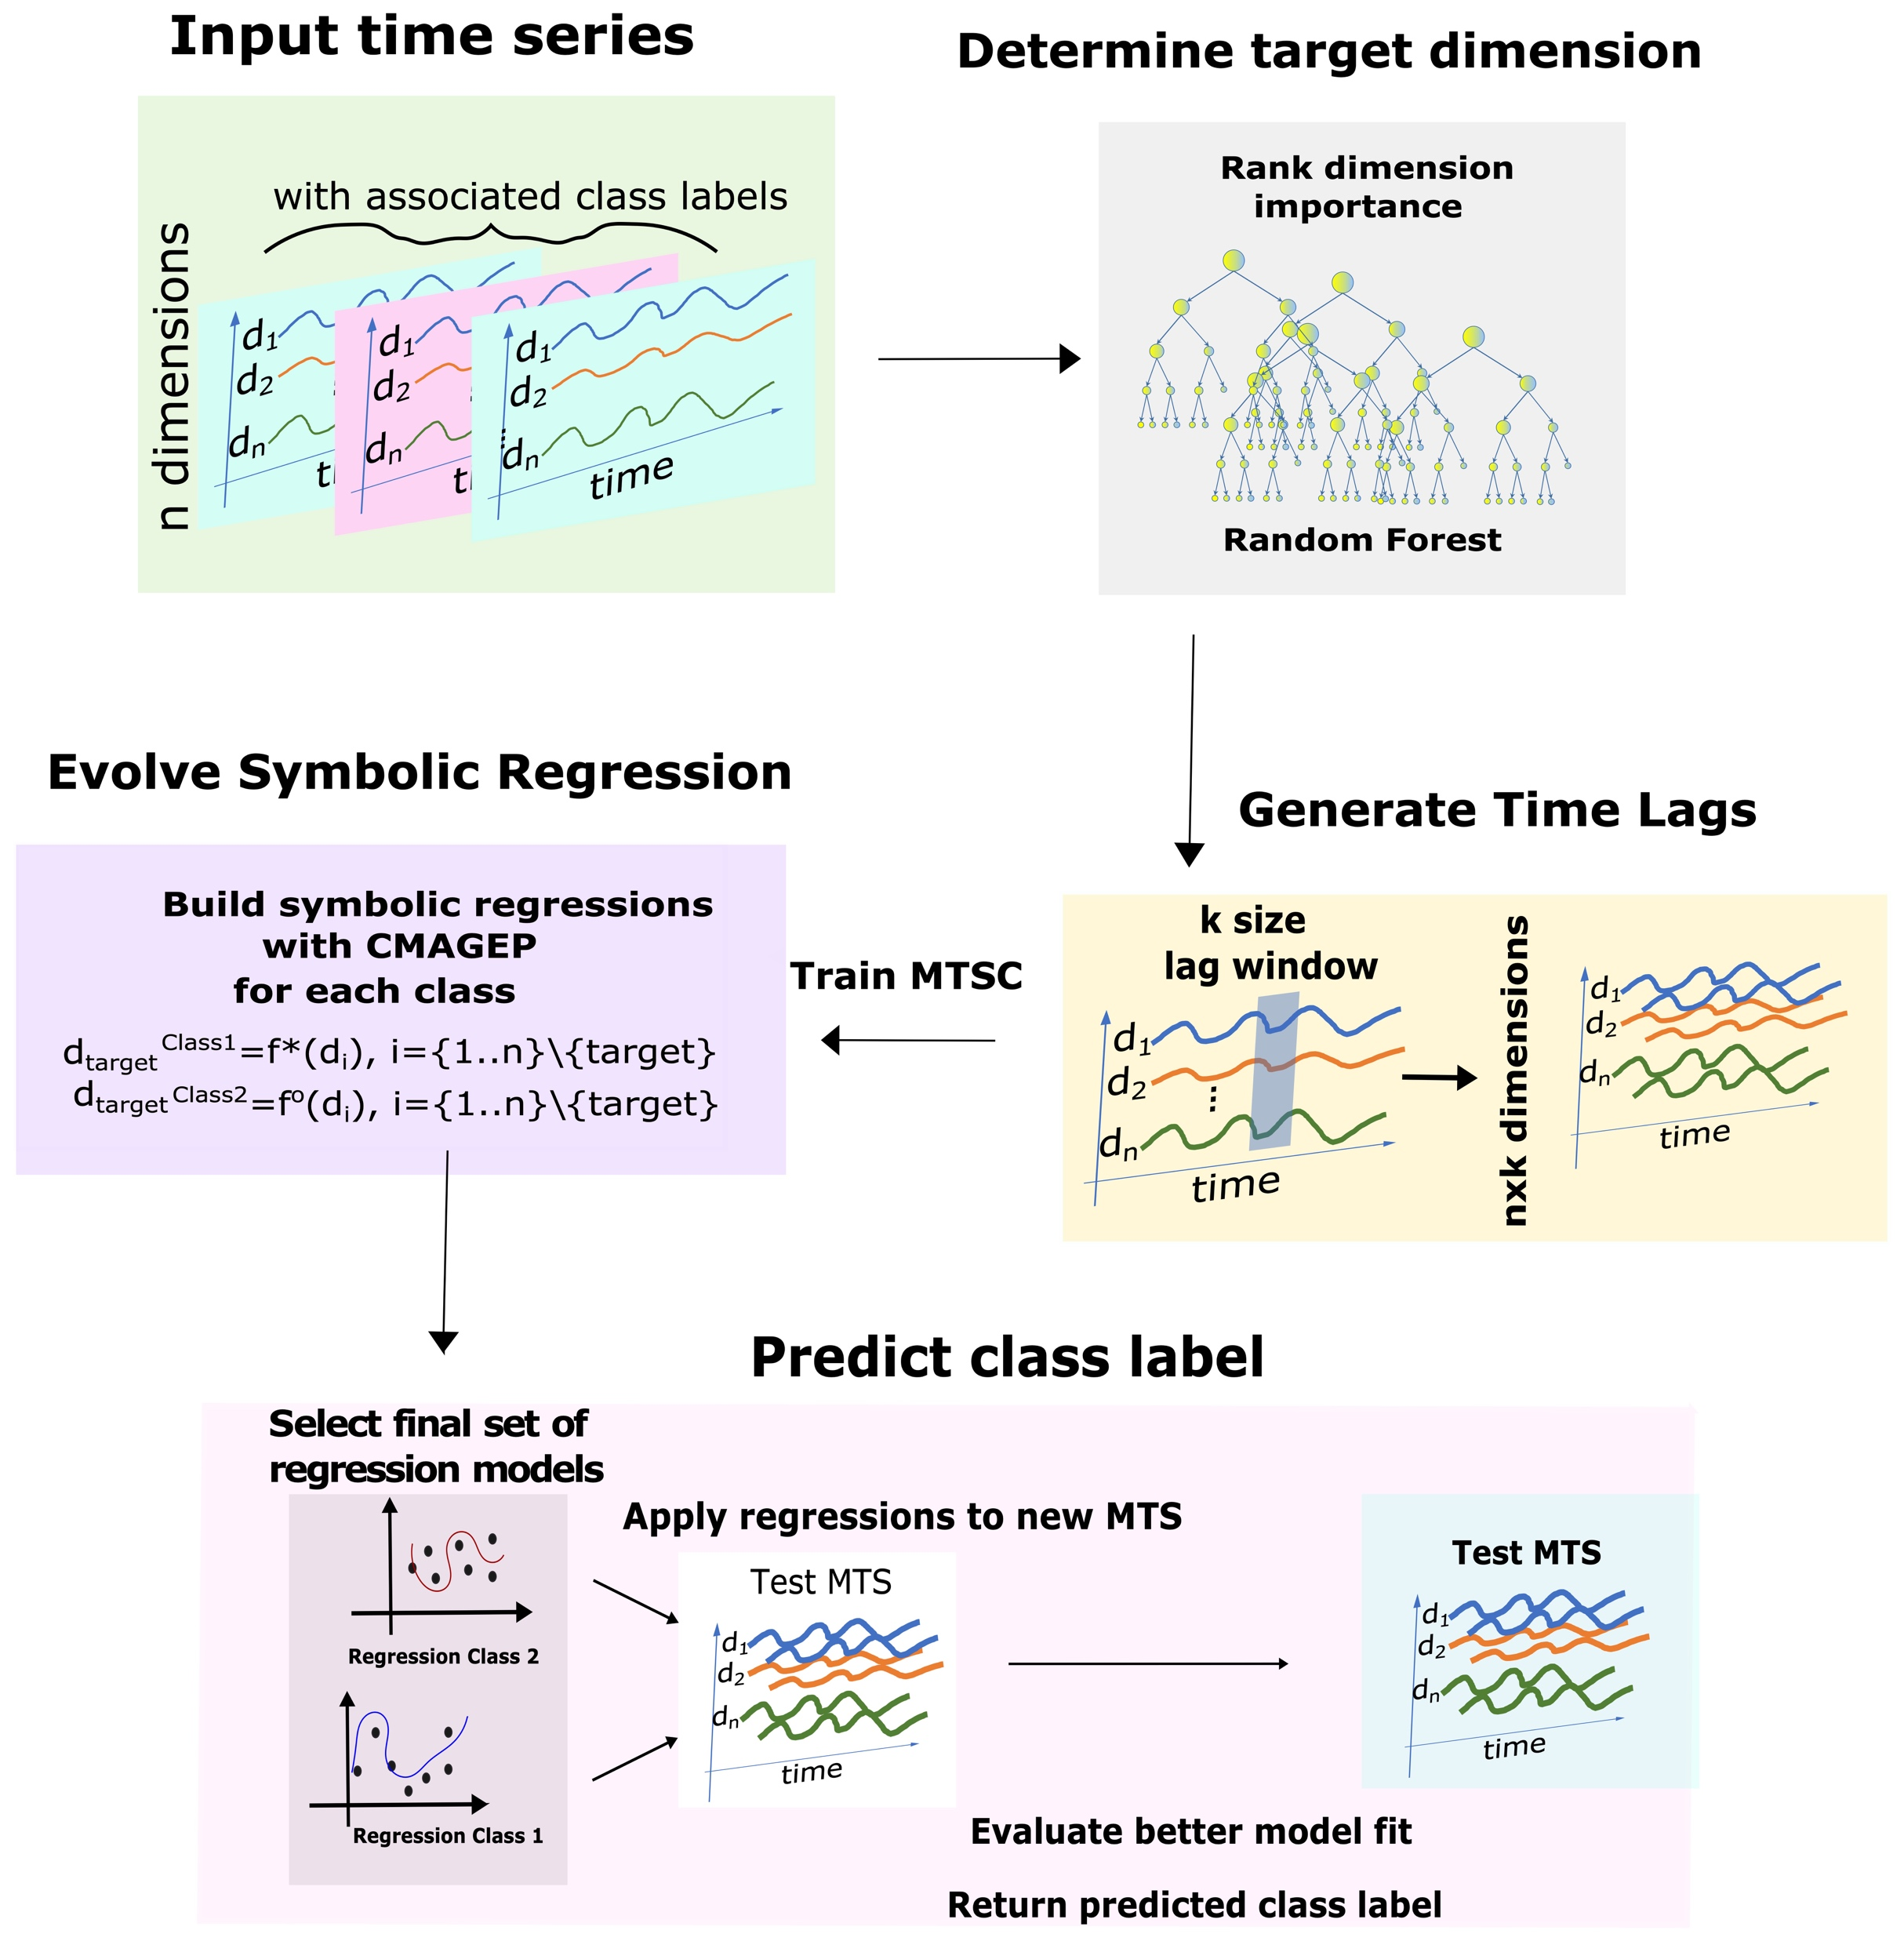
CMAGEP-MTSC

Slide 9
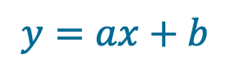
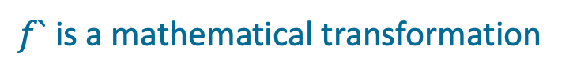
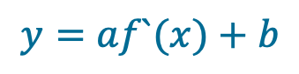
Symbolic Regression: Capturing Non-linearities
$$y=ax+b$$
Linear regression
Symbolic regression
$$y=af`(x)+b$$
$f`$ is a mathematical transformation
Notes:
Why SR

Slide 10
Symbolic Regression by CMAGEP

Slide 11
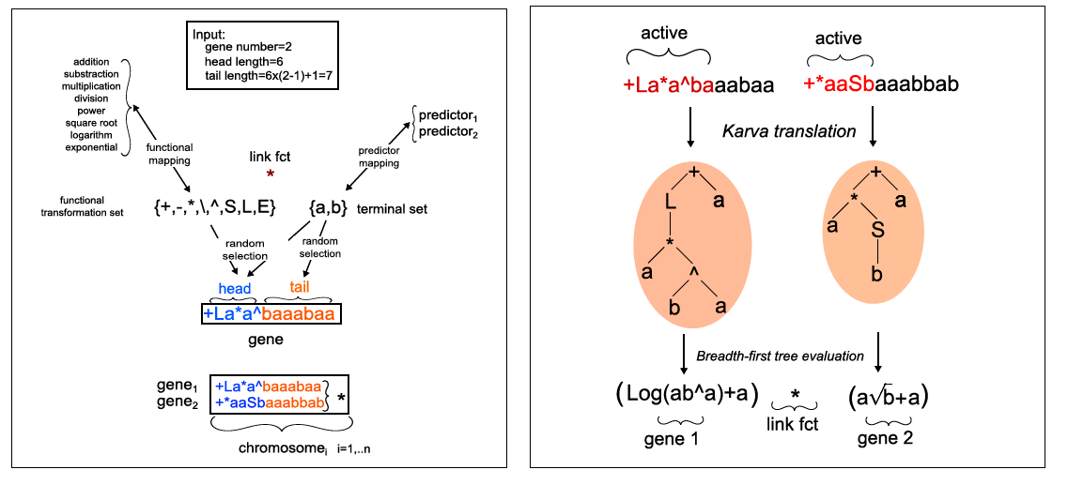
Symbolic Regression by CMAGEP

Slide 12
MTSC SOTA : Benchmark Datasets
Problem | No. Classes | Dimensions | TS length | Train | Test
ECG | 2 | 2 | 39-152 | 100 | 100
NetFlow | 2 | 4 | 50-997 | 803 | 534
Wafer | 2 | 6 | 104-198 | 298 | 896
KickvsPunch | 2 | 62 | 274-841 | 16 | 10
WalkvsRun | 2 | 62 | 128-1918 | 28 | 16
CMUsubject16 | 2 | 62 | 127-580 | 29 | 29
Notes:
Ordered by train size?

Slide 13
MTSC SOTA : Benchmark Accuracy
Method/Dataset | ECG | NetFlow | Wafer | KickvsPunch | WalkvsRun | CMUsubject16
SMTS | 0.818 | 0.977 | 0.965 | 0.82 | 1 | 0.997
LPS | 0.82 | 0.968 | 0.962 | 0.9 | 1 | 1
mvARF | 0.785 | NaN | 0.931 | 0.976 | 1 | 1
DTWi | 0.79 | 0.976 | 0.974 | 0.6 | 1 | 0.93
ARKernel | 0.82 | NaN | 0.968 | 0.927 | 1 | 1
gRSF | 0.88 | 0.914 | 0.992 | 1 | 1 | 1
MLSTMFCN | 0.87 | 0.95 | 0.99 | 0.9 | 1 | 1
FCN | 0.872 | 0.89 | 0.982 | 0.54 | 1 | 1
ResNet | 0.867 | 0.627 | 0.989 | 0.51 | 1 | 0.997
MUSE | 0.88 | 0.961 | 0.997 | 1 | 1 | 1
LR | 0.74 | 0.72 | 0.6 | 0.4 | 0.75 | 0.55
GLM | 0.77 | 0.73 | 0.6 | 0.4 | 0.75 | 0.55
CMAGEP | 0.98 | 0.996 | 0.998 | 0.86 | 1 | 1
Notes:
Single train/test split
Different order of datasets form previous table?
Ordered by dimensions, then train size or ts length?

Slide 14
MTSC SOTA : Benchmark Rank over 6 DS
Critical Diagram: mean ranks of MTSC methods over 6 DS
! CMAGEP beats the SOTA
Notes:
Critical difference diagram: explain what it is and what it shows
What are the top performing methods? What do they capture?

Slide 15
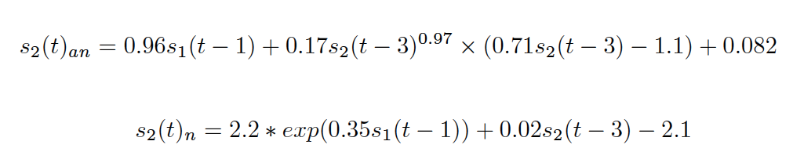
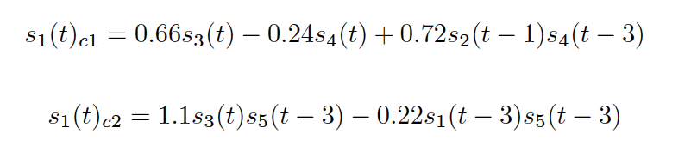
CMAGEP-MTSC: Models as Mathematical Functions
ECG
Wafer
Models have different structures for each class;
different features and transformations
Soundness cannot be verified without expert knowledge
Notes:
Discussion here: key ideas/points on slide

Slide 16
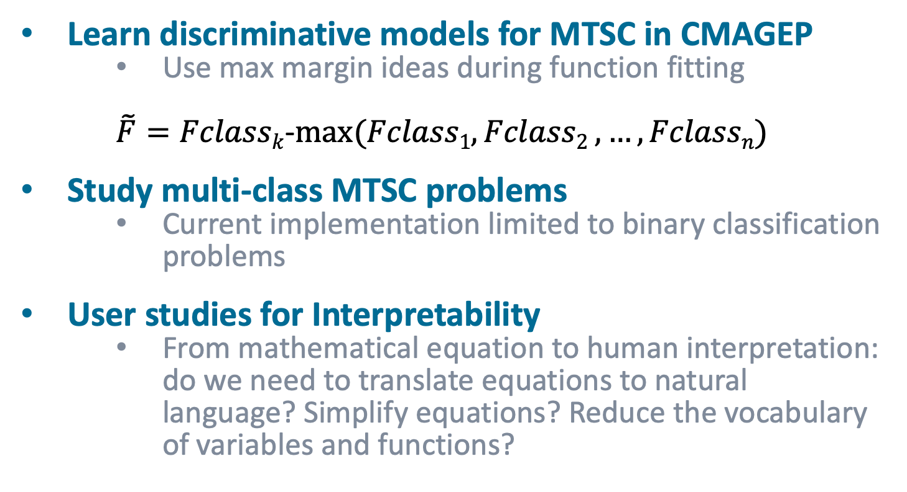
Future Work
Learn discriminative models for MTSC in CMAGEP
Use max margin ideas during function fitting
$\tilde{F}=Fclassk$-$max⁡⁡(Fclass1, Fclass2 ,…, Fclassn)$
Study multi-class MTSC problems
Current implementation limited to binary classification problems
User studies for Interpretability
From mathematical equation to human interpretation: do we need to translate equations to natural language? Simplify equations? Reduce the vocabulary of variables and functions?

Slide 17
Open Source Code Repository
The CMAGEP-MTSC code used to generate the current results is freely accessible at:
https://github.com/iuliailie/CMAGEP-MTSC

